Slide 1
HealthConnect Rwanda: Healthcare Operations and Performance Insights
Presented by
Adeyemo Taiwo Aminat
Data Analytics Track

Slide 2
The problem and what we analysed
HealthConnect needs to know where care, operations and finances can improve
Which hospitals and departments carry the heaviest workload?
Is revenue being collected, and are insurance claims paid?
How satisfied are patients, and where is it weakest?
20
20,000
health facilities
patients
60,000
42,036
bills and payments
insurance claims

Slide 3
Method and data quality
How the work was done
What the checks found
26 CSV files loaded into PostgreSQL
Quality checks and a cleaning log
40 SQL queries on cleaned views
Power BI dashboard with 6 pages and 26 DAX measures
No impossible ages, zero bills or orphan payments
55,000 of 60,000 bills and diagnoses not linked to appointments
19,308 feedback records not linked
Phone numbers damaged by Excel
No lab, prescription, admission or referral data

Slide 4
Executive view: a stable system with weak spots
20K
5K
RF9.31bn
Total patients
Appointments
Total revenue
20
350
2.99 / 5
Facilities
Doctors
Average satisfaction
Collection is strong at 90%, but satisfaction and claim approval are low.

Slide 5
Patients: older, chronic and evenly spread
45
28.5%
Gender is almost even: 10,090 male, 9,910 female
Provinces range only from 3,923 to 4,091 patients
Asthma, hypertension and diabetes each affect about 5,000 patients
Largest age group is 65 and over (5,701)
average age
aged 65 and over
74.6%
100%
have a chronic condition
hold an insurance ID

Slide 6
Clinical care and workload
Five diagnoses, each near 12,000 cases; none is rising
Severity is evenly split: mild, moderate, severe
About 417 appointments a month, steady all year
Emergencies are 33% of visits (1,650)
Busiest hospitals: HF013 (278), HF014 (276), HF010 (275)
Quietest: HF019 (217) and HF004 (222)
Heaviest departments: Cardiology (544), Radiology (525)
Lightest: ICU (467)
About 14 appointments per doctor

Slide 7
Financial performance
90.1%
RF920M
collected
outstanding
50.0%
RF155,157
claims approved
average bill

Slide 8
Operations and patient experience
Operations
Patient experience
1,250 staff: 700 nurses, 350 doctors
About 16 patients per staff member
2,000 beds, all recorded as available
200 pieces of equipment, 10 per hospital
Staffing is even, but demand is not
Average rating 2.99 out of 5
40.4% poor ratings, 19.7% excellent
Best: HF011 (3.19), HF001 (3.12)
Lowest: HF007 and HF020 (2.76), HF014 (2.77)
ICU is the lowest department (2.76)

Slide 9
Four insights that matter
1
HF014 is the second busiest hospital and one of the lowest rated (2.77).
2
RF920M is unpaid, and bills marked Paid still show RF311M unpaid.
3
Only half of 42,036 claims are approved, at every insurer, so the cause is internal.
4
Data gaps limit analysis: 55,000 unlinked bills, and no referral, lab or bed data.

Slide 10
Recommendations
Recommendation | Evidence
Match staffing to demand | HF013, HF014 and HF010 handle 275 to 278 visits; HF019 and HF004 handle 217 and 222, yet staffing is even
Recover unpaid bills | RF920M outstanding (9.9%); RF311M gap even on bills marked Paid
Raise claim approval | 50% of claims approved at every insurer, so review documentation and submission
Fix low satisfaction | 40.4% poor ratings; HF014 is busy and rated 2.77; ICU lowest at 2.76
Serve older and chronic patients | 28.5% are 65 and over; 74.6% have a chronic condition
Improve data capture | 55,000 bills unlinked; no referral, lab, admission or bed data

Slide 11
Conclusion and next steps
HealthConnect collects 90% of what it bills and has steady patient flow
Three weaknesses stand out: uneven staffing against demand, 50% claim approval, and 2.99 satisfaction
Most patients are older or chronically ill, which should guide service planning
Next steps
Pilot a staffing shift toward the three busiest hospitals
Review the claims process and reconcile bill status with payments
Capture linked, complete data so the dashboard can measure beds, referrals and lab work

Slide 12
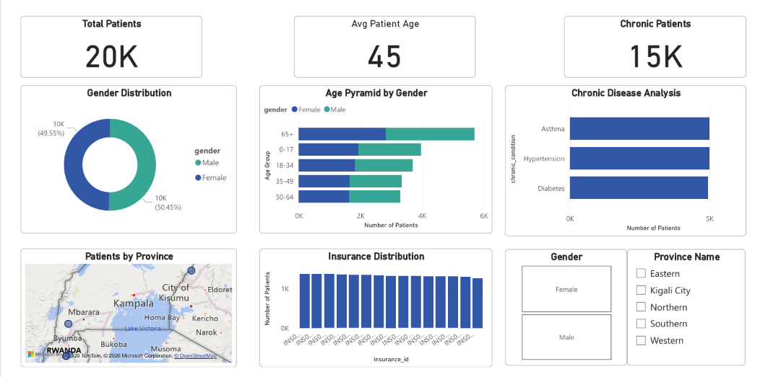
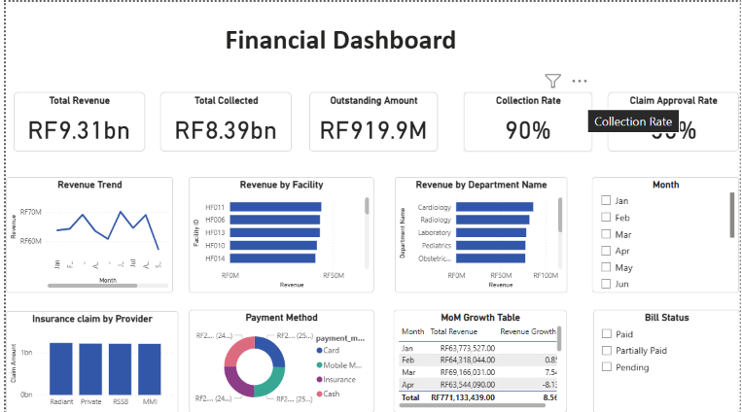
Dashboard

